Slide 1
RULES FOR THE 2019 SOLAR CAR CHALLENGE

Slide 2
EVENT UPDATES
The Rules are periodically clarified or amended to meet the needs of the specific race.
Rule 29 requires solar car teams to make periodic reviews of these updates to stay up-to-date.

Slide 3
Rules Overview
Do:
Keep copies of rules throughout workshop
Following engineering lifecycle: requirements, design, implementation, verification
Don’t:
Just read once or all in one sitting
Look at another car’s design and assume it complies with rules (grandfather; waivers)

Slide 4
Important Dates
September 1 to January 31 - “Intent-to-Race” Form
This notifies Race Officials that you plan to participate in the 2019 Solar Car Challenge, and places your team on a mailing list to receive Event Updates and other mailings.
March 1st - File Registration Document
This includes full documentation about your solar car project as required by Rule 3.6.

Slide 5
Registration
Sections 1 – 3: Purpose, Administration, Entries and Registrations
Registration Documents requirement March 1st:
(1) Detailed drawings showing mechanical structure, including “crush zones.” Crush zones must be clearly labeled.
(2) Detailed schematic / wiring diagram showing electrical system.
(3) Digital team photo [emailed]
(4) Manufacturer’s data sheets for batteries
(5) Manufacturer’s data sheets for solar array, including list price
(6) Manufacturer’s data sheets for motor and motor controller
(7) Manufacturer’s data sheets for array and battery cutoff switches
(8) Manufacturer’s data sheets for main fuses
(9) Manufacturer’s data sheets for wheels and brakes
Digital and hard copies required
[Rule 3.6]

Slide 6
Section 10: DIVISIONS
Classic Division: No hub motors; lead-acid batteries; solar modules at ≤ 19% efficient
Advanced Classic Division: participated in 3 or more years in classic
Advanced Division: Hub motors; prefabricated solar car molds; advanced battery chemistries
Electric-Solar Powered Car Division: Solar cells on charging station; Classic Division technology; 2 x 2kWh battery packs

Slide 7
Section 5: SOLAR CAR REGULATIONS 5.1 – Dimensions – Length = 5m, Height = 1.6m, Width = 1.8m 5.1.2 – Stability [Tilt Test] 5.1.3 – Body of Vehicle – windshields required, but body is not required unless judges determine that driving without a body would be unsafe. A belly pan is required. 5.2 – Structure – teams must be able to demonstrate specific, adequate “crush zones.” 5.2.1 – Roll Cage welded to frame (1.9cm OD, 5cm clearance) 5.2.2 - Crush zones (15cm from driver in all directions) 5.2.3 – Roll Bar welded to frame 5cm above driver’s head (5cm OD) 5.4 – Batteries (5 kWh max @20hr discharge rate) 5.4.2 – Main Battery Pack Fuse [125% expected peak current and in separate enclosure for fuse; DC rated] 5.4.3. – Battery Enclosure / Fans (Main & Supplemental)

Slide 8
Section 5: SOLAR CAR REGULATIONS 5.1 – Dimensions – Length = 5m, Height = 1.6m, Width = 1.8m 5.1.2 – Stability [Tilt Test] 5.1.3 – Body of Vehicle – windshields required, but body is not required unless judges determine that driving without a body would be unsafe. A belly pan is required. 5.2 – Structure – teams must be able to demonstrate specific, adequate “crush zones.” 5.2.1 – Roll Cage welded to frame (1.9cm OD, 5cm clearance) 5.2.2 - Crush zones (15cm from driver in all directions) 5.2.3 – Roll Bar welded to frame 5cm above driver’s head (5cm OD)

Slide 9
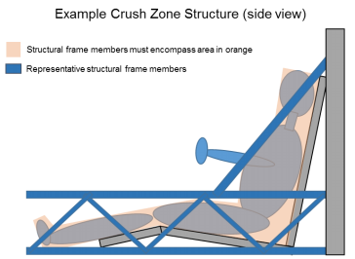

Slide 10
Section 5.4 - ELECTRICAL
[5.4] Batteries: 5 kWh max at 20 hr discharge rate
[5.4.2] Main Fuse: 125% of expected peak current, separate enclosure, DC rated; “Fast Blow” or “Very Fast Blow” ← Made by Copper Bussman (~$20) ANN = Very Fast Acting
[5.4.3] Enclosures: Rigid, must have forced-air ventilation
[5.4.4] Supplemental Batteries: Powers all devices other than propulsion; must have low battery warning system
[5.4.5] Disconnect Switches: Must be push-off; 2 each of motor and array disconnects

Slide 11
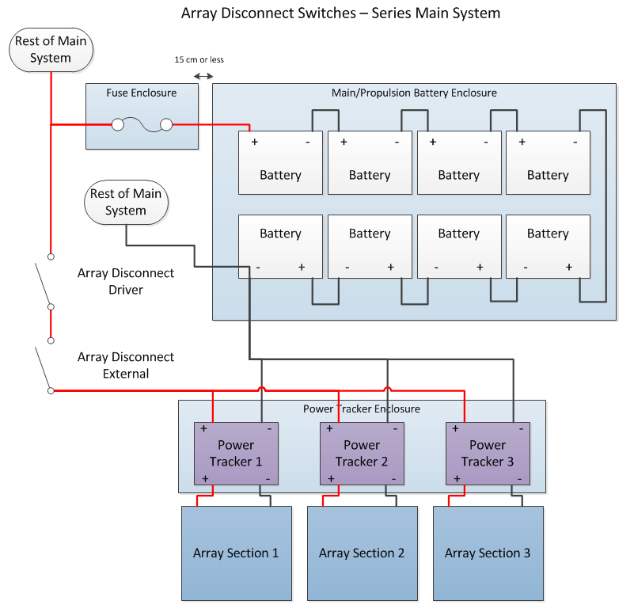

Slide 12
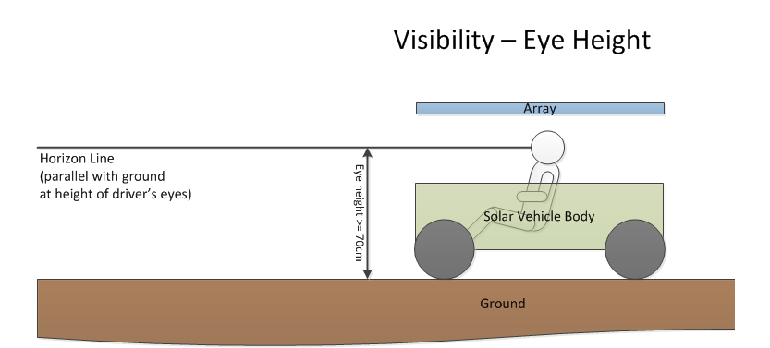
5.5 – Electrical System Grounding – no grounding to frame 5.7 – Wire, Insulation, Connections – properly sized wire (use wire table; sized to continuous system current) 5.9 – Visibility

Slide 13
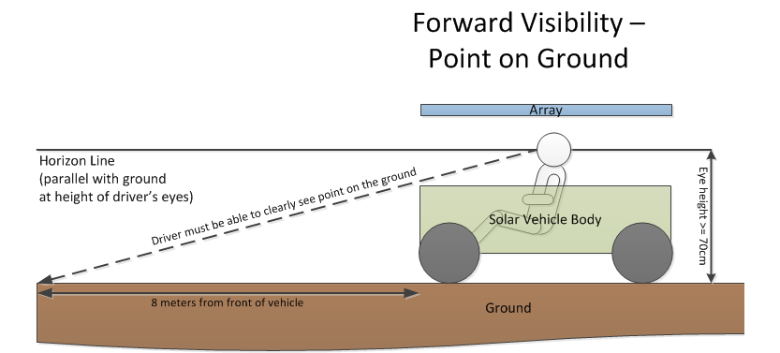

Slide 14
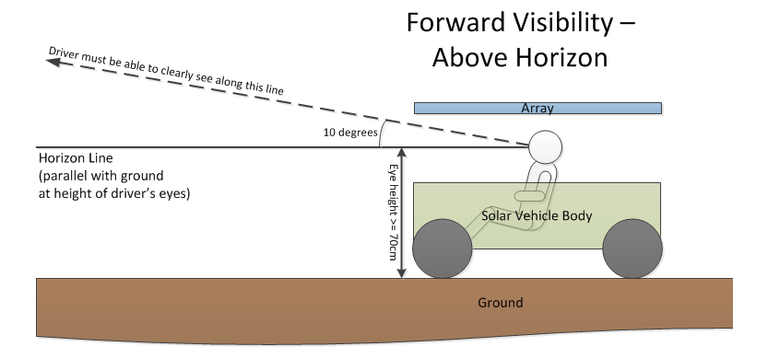
height_{pole}
height_{eye}
distance_{pole}
Scrutineering Measurement: tan⁻¹ (height_{pole} – height_{eye} / distance_{pole})

Slide 15
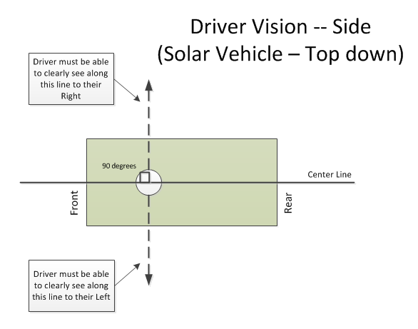
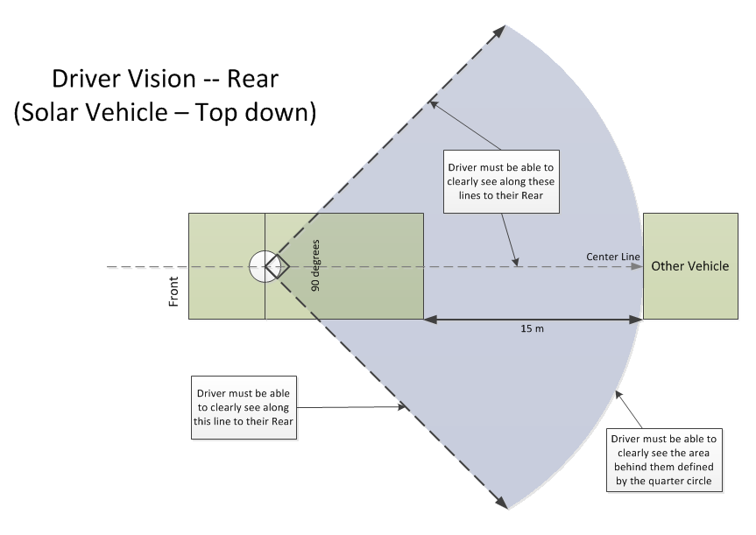

Slide 16
5.10 – Braking test at Low Speed and High Speed 5.11 – Steering and turning radius [15-meters] 5.12 – Warning Systems – Turn Signals, Hazards, and Horn 5.13 – Driver Safety (a) Safety Belt – 5 point lap & shoulder belt [Grade 8 bolts] attached to frame of solar car (b-c) Impact Protection (body shells attached) (d) Windshield must protect driver’s entire face (e) Cockpit egress in 15 seconds (f) Fire extinguishers [Appropriate to battery type] (g) Liquid container properly secured to the vehicle (h) belly pan (i) Forced Air Circulation (j) Driver seat provides neck support & is bolted to frame (k) Battery spill kit (baking soda) (l) Closed toe shoes/hats (m) Protective Eyewear in garage area

Slide 17
5.14 – Throttle 5.15 – Covers & Shields 5.16 – Electrical shock hazards 5.17 - Radios 6 – Nature of the Event – Closed Track Race Teams accumulate laps driving around Texas Motor Speedway. Partial laps do not count. The team achieving the most laps over the four days of racing will be declared the winner. 6.1 – Elapsed time 6.2 – Taking part in special events and Challenge Event 6.3 – Items provided by Race 6.4 – Items provided by participants 6.5 – “Trailering” provisions 6.8 – Charging 6.9 – Impound 7 – Scrutineering 8 – Registration 8.3 – Registration Fee is increased 8.4 – License plates – June 1 deadline for liability insurance 8.5 – Team guests must comply with race rules

Slide 18
Sections 9, 11-21: How the race is run; read to understand what a day is like 19. Support vehicles – teams must have a support vehicle with trailer so that they can go out onto the track to pick up the solar car in the event of a break down. 23. Judging 24. Penalties 25. Protests 29. Responsibility to CHECK UPDATES

Slide 19
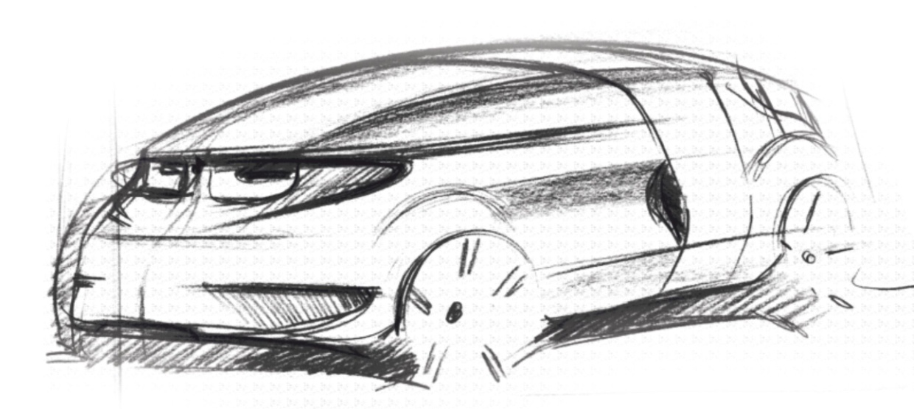
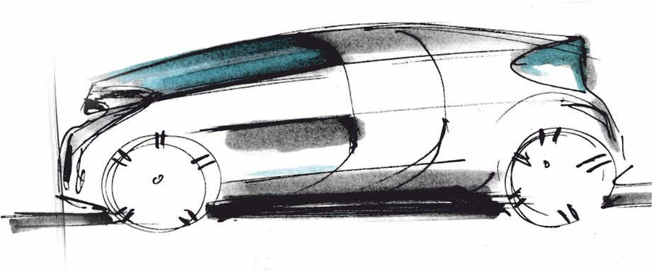
32 – Electric-Solar Powered Car Divisiom

Slide 20
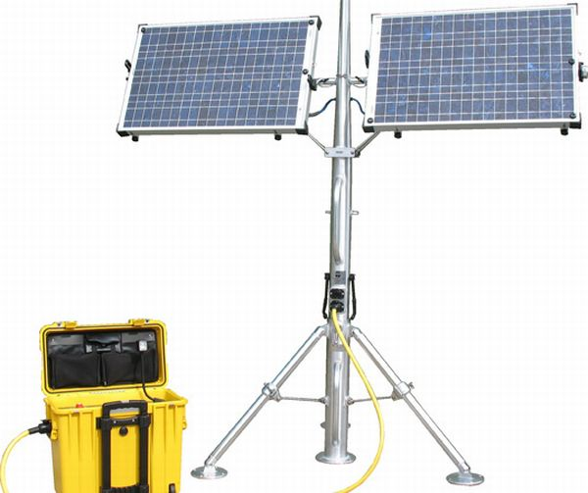
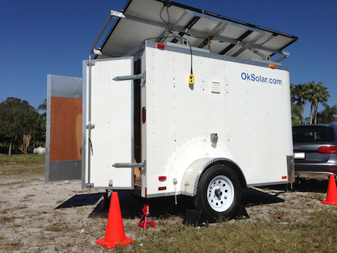
32.1 Concept – The Electric-Solar Power Car Division is designed to simulate a “real world” solar application. (a) Two passenger vehicle (b) Solar Power Charging Station simulates a permanent facility that would be used to charge the vehicle

Slide 21
32.2 Physical Regulations 32.2.1 The Electric-Solar Power Car is governed by all the regulations set out for a Classic Division Solar Car, except where exceptions are provided in this Addendum. 32.2.2 Dimensions – the Electric-Solar Power Car will have the following minimum dimensions: Length – 4.5 meters; Height – 1.5 meters; Width – 1.5 meters. (no maximum dimensions) 32.2.3 Configuration – the Electric-Solar Powered Car must accommodate two passengers. 32.1.3 (a) - The passengers must be seated in a comfortable upright position to simulate a “real world” environment. 32.1.3 (b) - One passenger will be designated the “driver”; the other passenger will be designated the “technician” for communications, data collection, and strategy coordination.

Slide 22
32.2.4 Driver Weight – the minimum weight of the two drivers must be a total of at least 320 pounds. If the sum of the drivers’ weight is less than 320 pounds, the solar car must carry a ballast. 32.2.5 Power – powered by interchangeable battery boxes charged by the sun at the team’s Solar Power Charging Station. 32.2.6 Battery - teams can have two battery boxes: one battery box will be in the solar car; the other battery box will be charging at the Solar Power Charging Station. Battery packs have 2 kWh max each.

Slide 23
32.3 Solar Power Charging Station 32.3.1 Array – the solar power charging station can have an array no larger than 5 meters by 1.8 meters. Solar Cells must be 19% efficiency or less. 32.3.2 Location – charging station in designated area, permanent once set up; can be rotated 32.3.3 Stability/Durability – the solar power charging station must be a stable facility capable of withstanding reasonable weather conditions. This includes gusts of wind up to 40 mph and rain. 32.4 Battery Box Exchange Procedures 32.4.1 Batteries exchanged in designated area; monitored by judge 32.4.2 Once installed, solar car moves back onto race course. 32.4.3 Every car will drive a defined track 32.7 Team Assignments – Perform special “real-world” task each day

